Slide 1

Enterprise Sales Analytics Report
Pizza Division Performance Analysis
Data-driven insights from 48,620 transactions across one fiscal year

Slide 2

OVERVIEW
Business Challenge
Strategic Questions
Which products drive highest revenue and volume?
Senior management needed consolidated, data-driven answers to optimize operations
When do customers order most frequently?
How to translate insights into measurable actions?

Slide 3
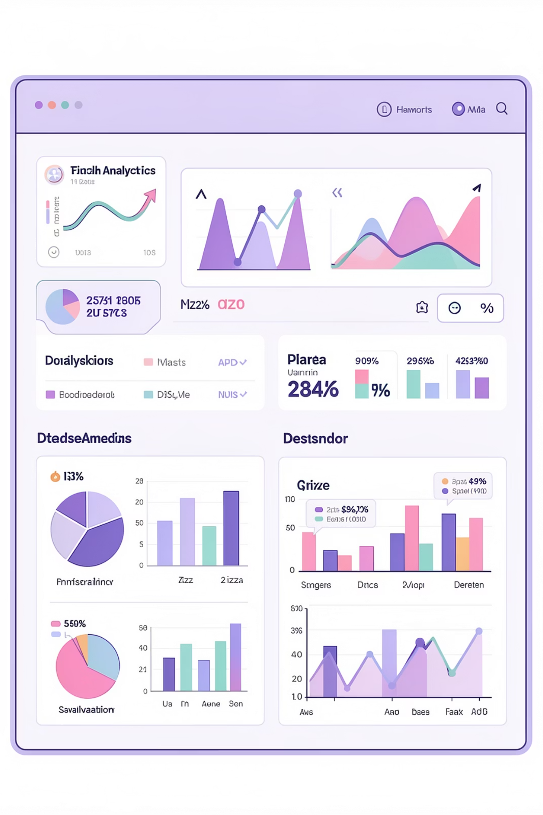
Project Scope
48,620
21,350
$817,860
Transaction records analyzed
Unique customer orders
Total revenue generated
1 Year
Full fiscal period

Slide 4
KEY METRICS
Performance at a Glance
$817K
49,574
$38.31
Total Revenue
Units Sold
Average Order Value
Annual sales performance
Total pizzas delivered
Revenue per transaction

Slide 5
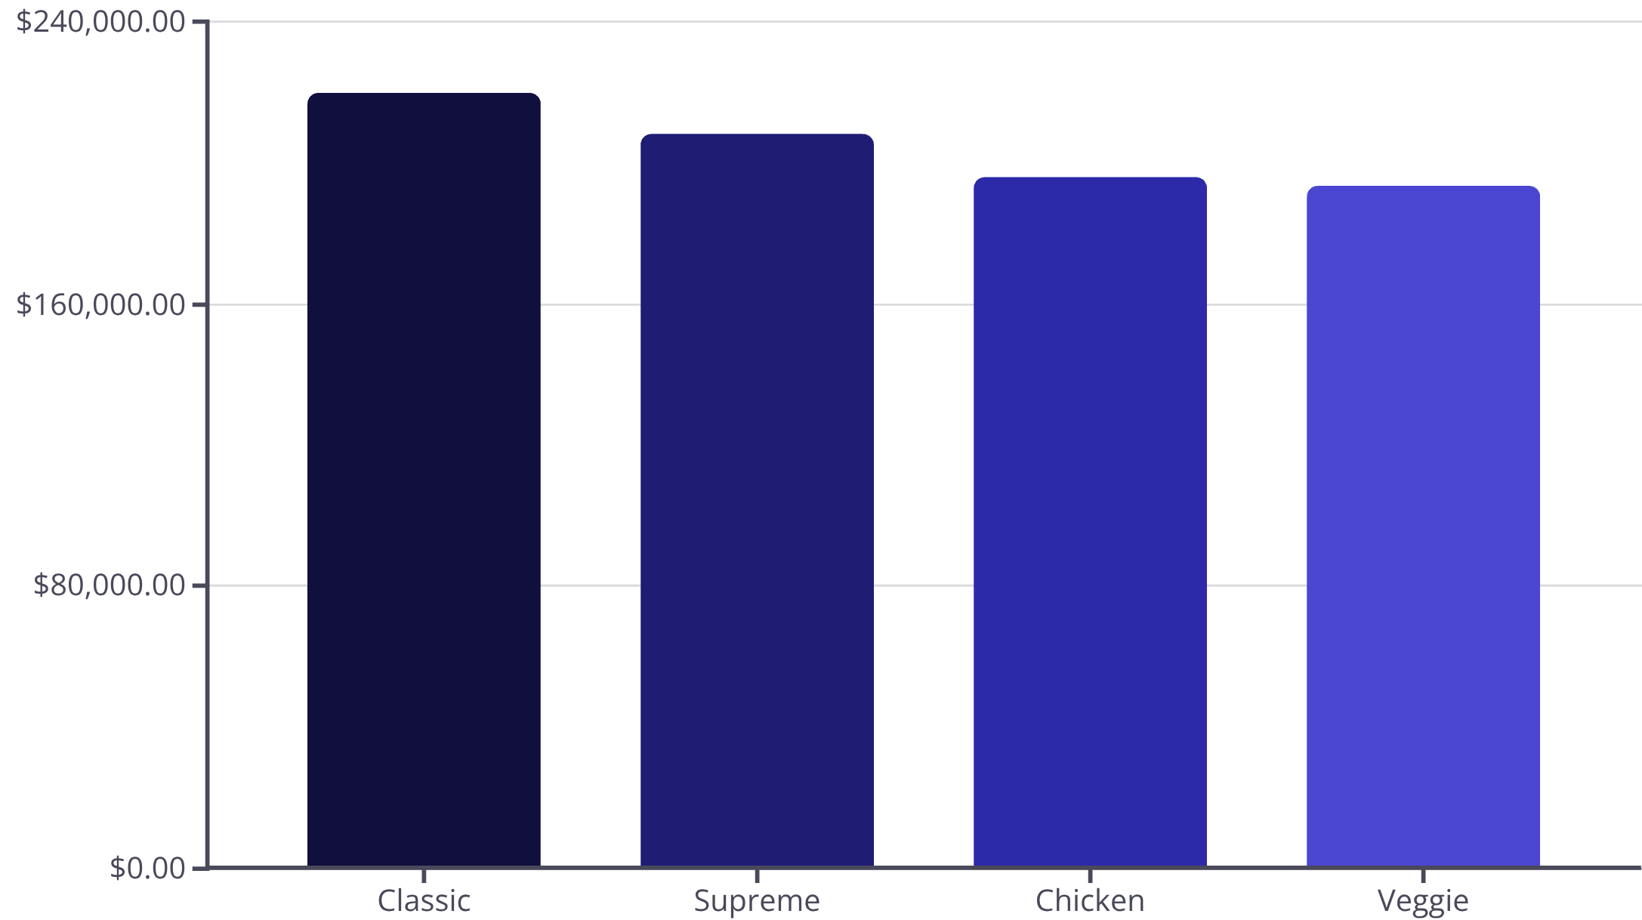
Revenue by Category
Category Performance
Classic and Supreme categories lead revenue generation, representing nearly 52% of total sales.
All categories show strong performance with relatively balanced distribution, indicating healthy product mix.

Slide 6

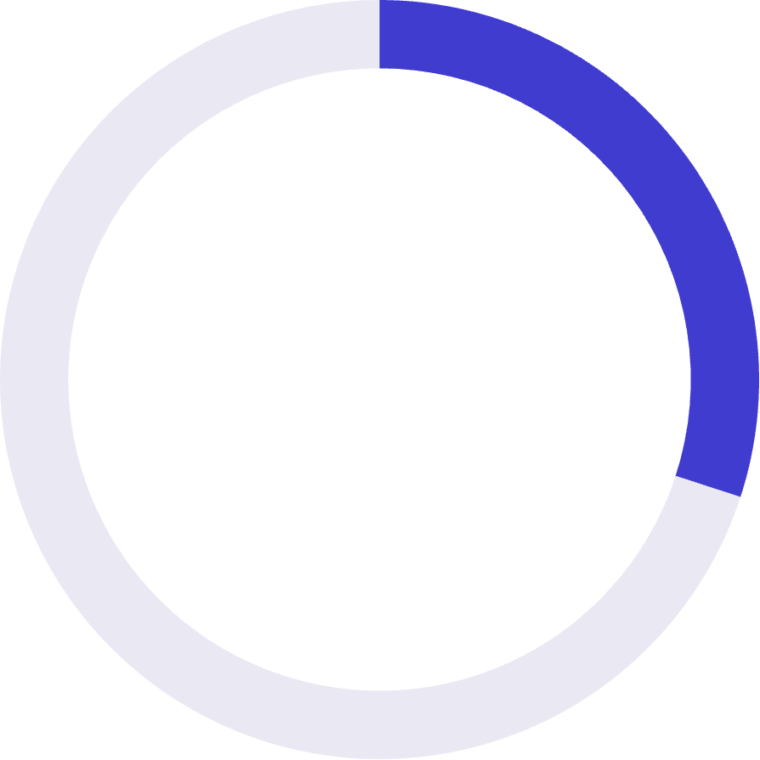
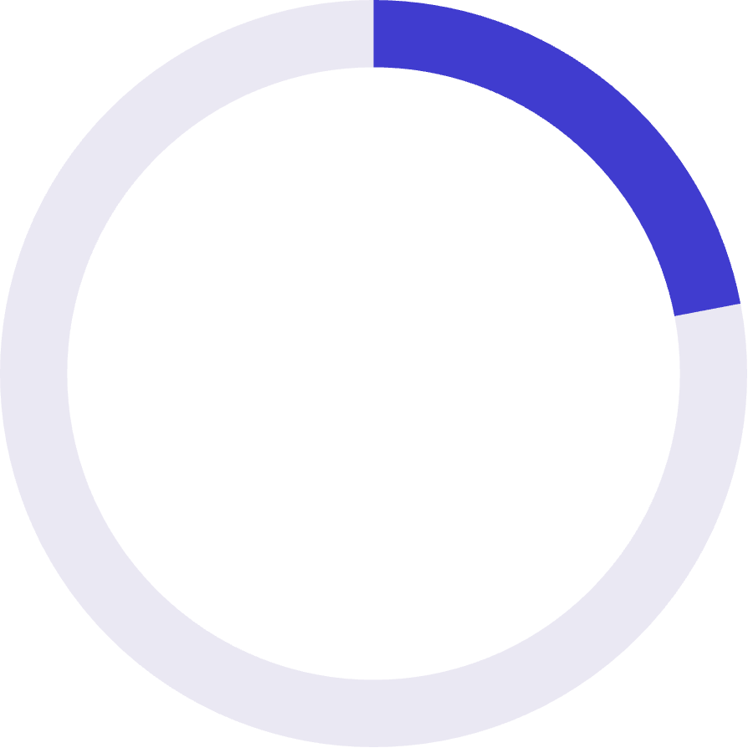
Size Matters: Revenue Distribution
The Large Advantage
Large pizzas contribute 46% of total revenue while representing lower order volume.
This indicates significant pricing leverage and upsell opportunity.
46%
30%
22%
Large size revenue share
Medium size contribution
Small size portion

Slide 7



Temporal Patterns
Peak Day: Friday
Peak Month: July
Top Product
$136,074 revenue - highest performing day drives weekend momentum
$72,558 revenue - summer season shows strongest demand
Classic Deluxe Pizza: 2,453 units sold

Slide 8

INSIGHTS
Strategic Recommendations
Promote Large Size Upsells
1
Target peak hours to maximize average order value through size-based promotions
Optimize Staffing Levels
2
Align workforce with Friday peaks and high-revenue months for operational efficiency
Rationalize Menu Offerings
3
Bundle high-volume classics with lower-performing SKUs to improve product mix
Targeted Weekday Promotions
4
Drive demand during low-performing days like Sunday and Monday

Slide 9




Analytical Approach
SQL Analysis
Revenue aggregation, ranking, time-based analysis
Python Processing
KPI computation, validation, trend analysis
Tableau Dashboards
Executive visualization, interactive drill-downs

Slide 10

Business Impact & Next Steps
Single Source of Truth
Revenue Optimization
Consolidated sales performance enables proactive decision-making
Direct support for pricing strategy and product positioning
Future Enhancements
Integrate cost and margin data for profitability analysis
Apply demand forecasting for inventory optimization
Automate dashboards for near real-time monitoring

